Slide 1
Market research – Restaurants L.A
Robot-run Café

Slide 2
Background
Opening a small robot-run Café in Los Angeles is promising idea but expensive.
The investors are interested in the current market conditions, hence open-source data on LA restaurants market used to prepare some market research with a goal to understand how market is represented in:
Restaurant types proportions
Competition
Size (in terms of average number of seats)
Location

Slide 3
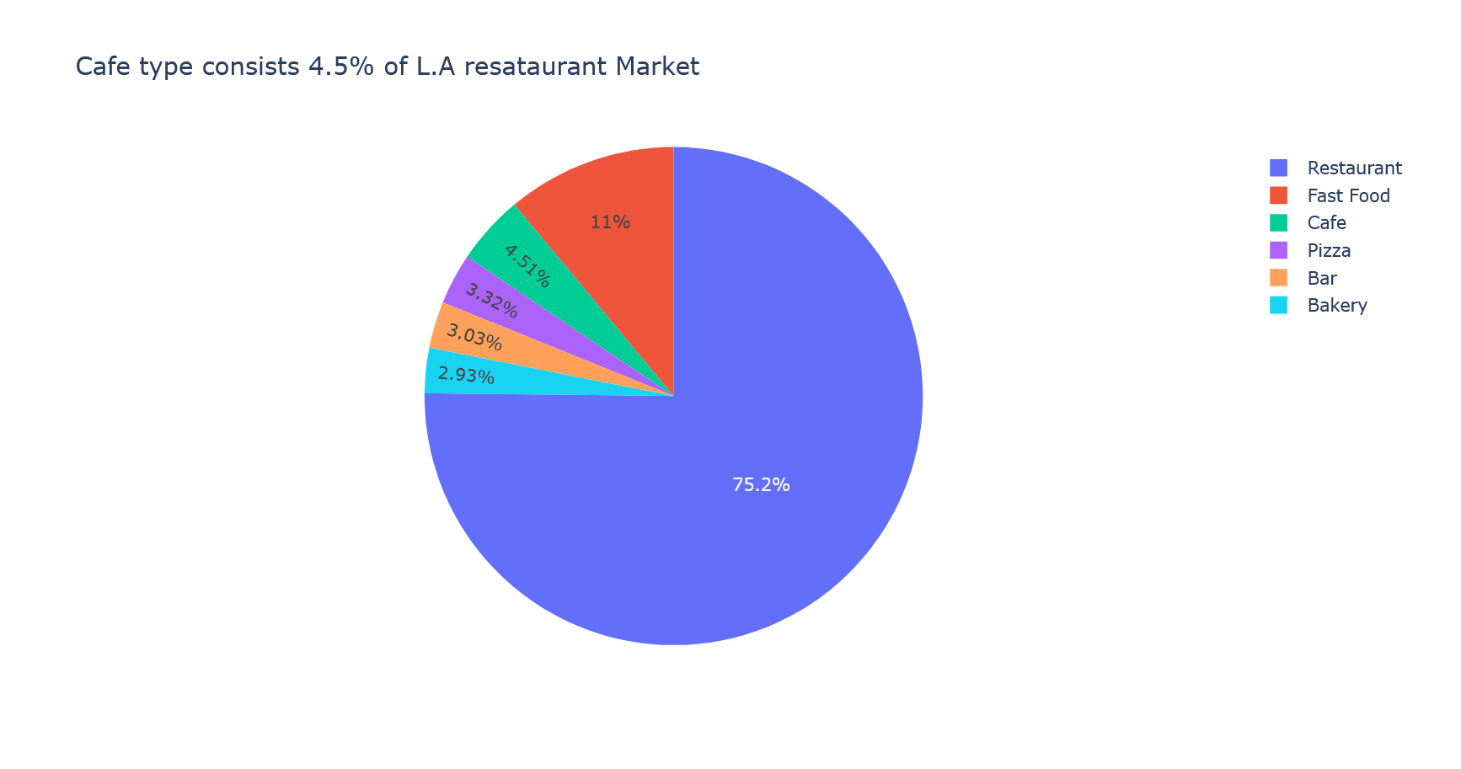
Market Research: L.A Restaurant types proportions

Slide 4
Market Research: L.A Restaurant types proportions
75% of the restaurant market in L.A. is dominated by Restaurants.
11% is Fast Food restaurants share.
The robot-run Cafe will fit the 4.5% Cafe type share.
Bakeries, Bars and Pizzas holds around 3% market share each.

Slide 5
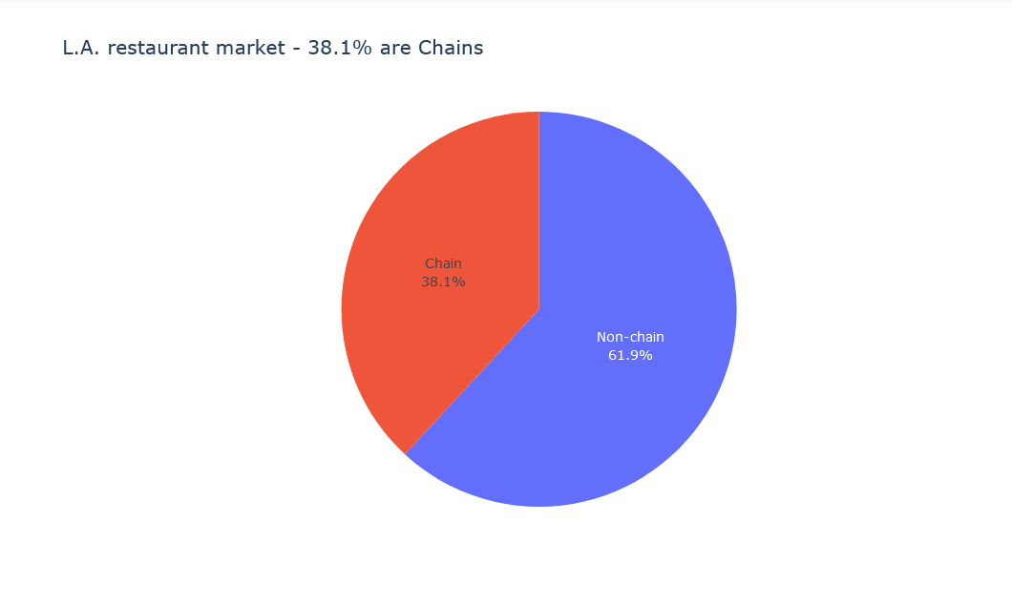
Market Research: Competition market condition

Slide 6
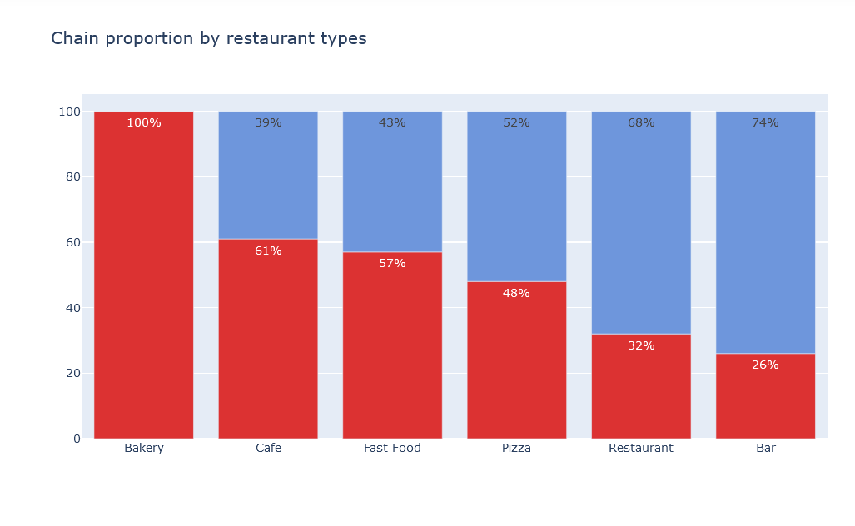
Market Research: Competition market condition

Slide 7
Market Research: Competition market condition
The most common combination of restaurant type and chain belongs to Bakery type - all of them chains.
Around 60% in Cafe and Fast-Food restaurants are chains.
Pizza's type have almost 50% chain belonging .
The least common combination of restaurant type and chain are Bars and Restaurants. Those types have between 26%-32% chains.

Slide 8
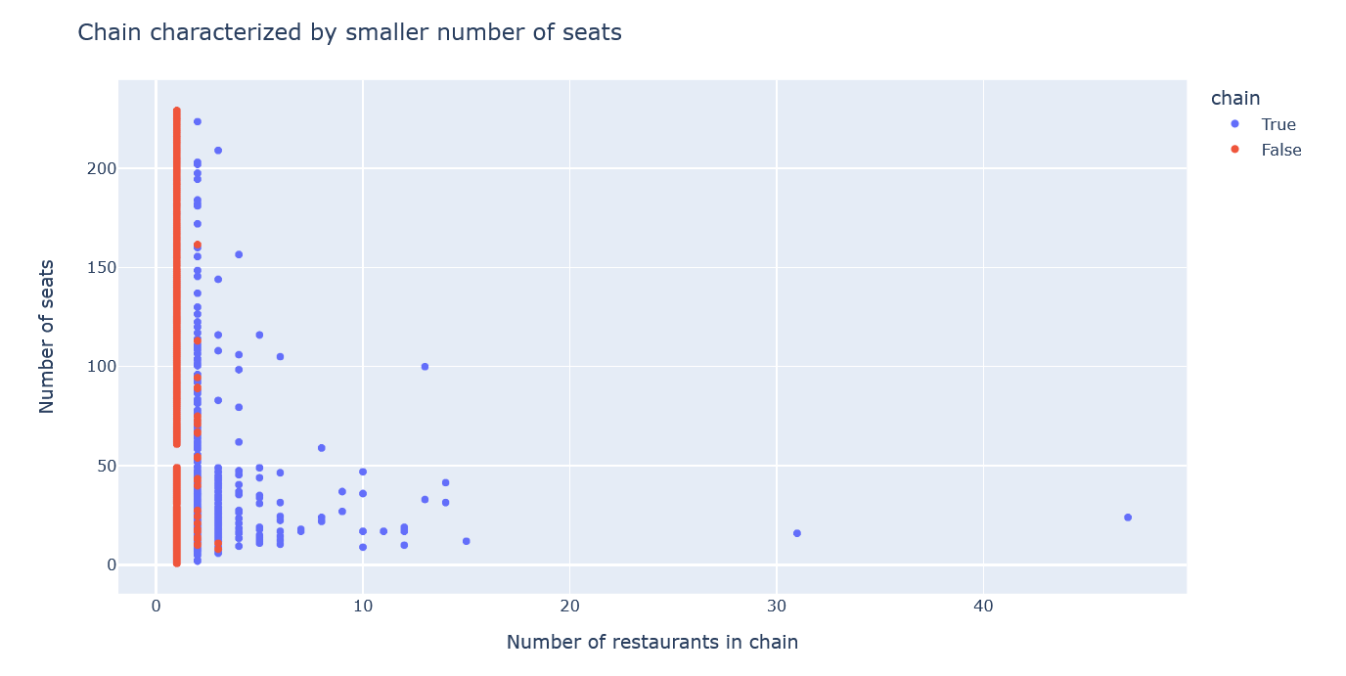
Market Research: Size condition - Chain characteristics
The more establishments there are in a chain,
the smaller average number of seats.

Slide 9
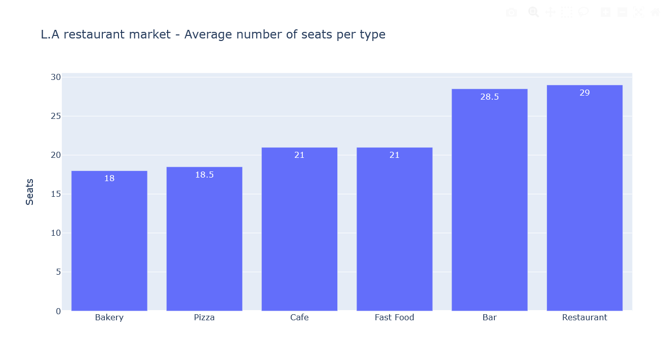
Market Research: Size condition – Average number of seats

Slide 10
Market Research: Size condition – Average number of seats
On average Restaurants and Bars demands more space, they have the greatest number of seats - around 29.
Cafe and Fast-Food types are smaller sizes and have 21 seats on average.
Pizza and Bakery types has 18 seats on average.

Slide 11
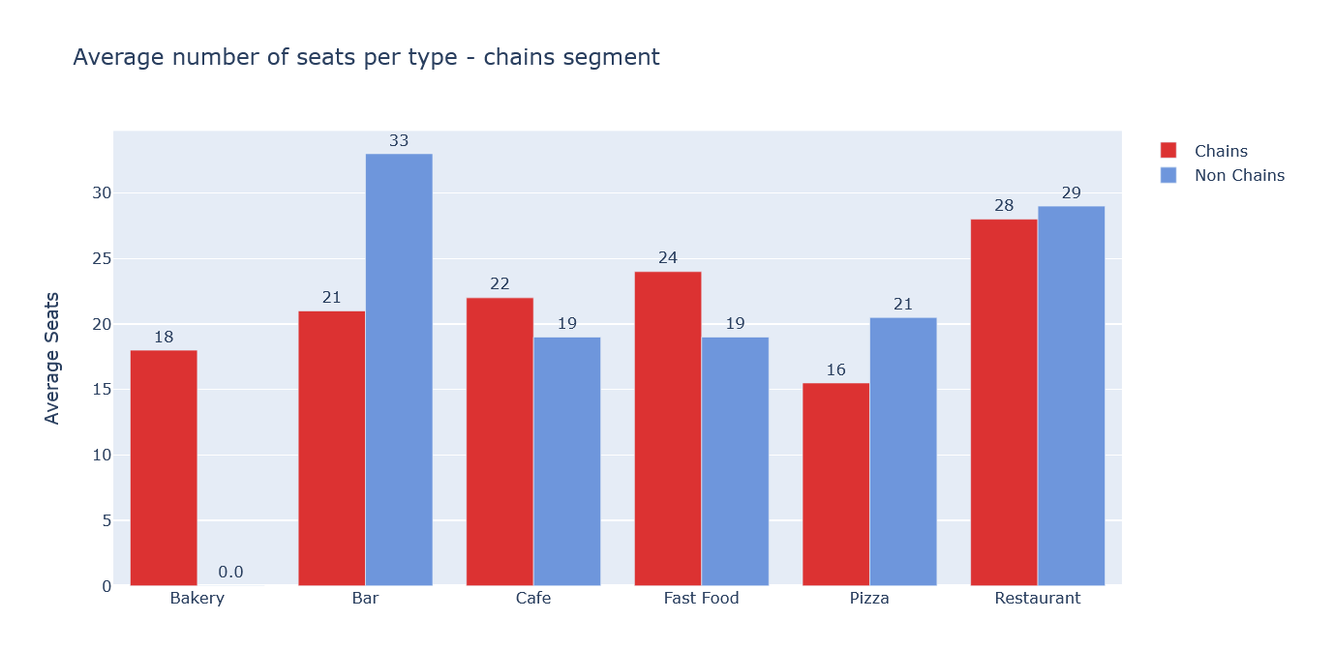
Market Research: Size condition – Average number of seats

Slide 12
Market Research: Size condition – Average number of seats
In Cafes' and Bakeries restaurant types Chains have a few chairs more than non-chain restaurants.
Restaurants, Bars and Pizzas' non-chain establishments on average have higher number of seats.

Slide 13
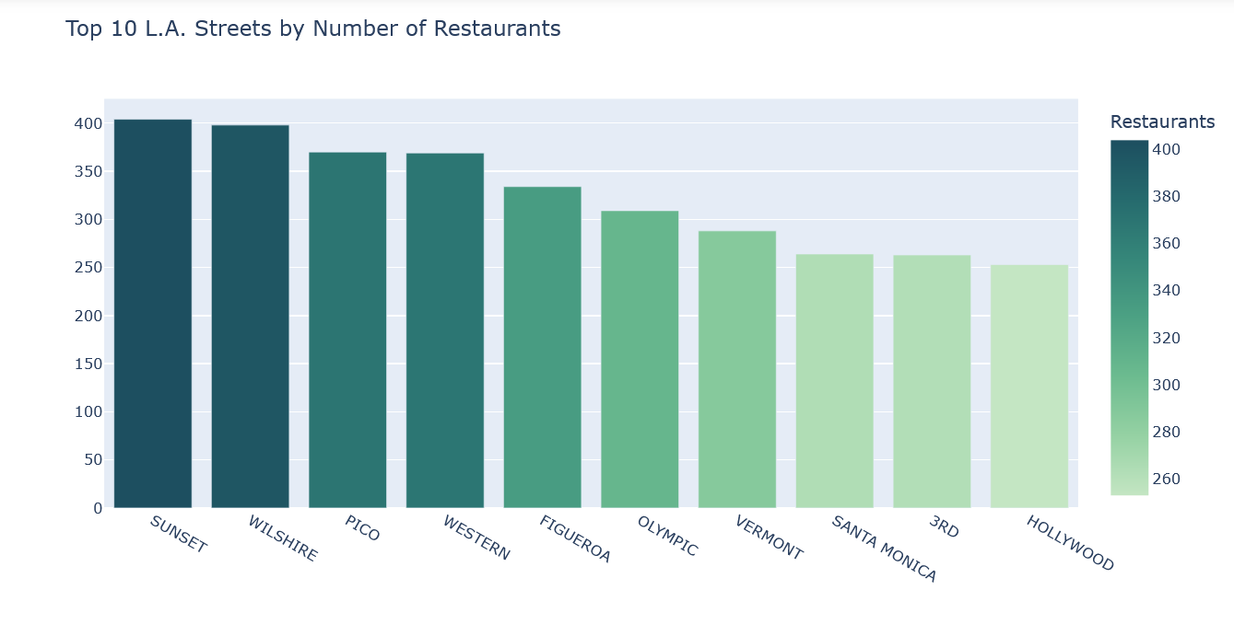
Market Research: Location condition

Slide 14
Market Research: Location condition
Those are the 10 top streets that all types of restaurants located in. Those are the streets that restaurant types want to be.
The range of restaurants is between 250-400 restaurants types in each street.

Slide 15
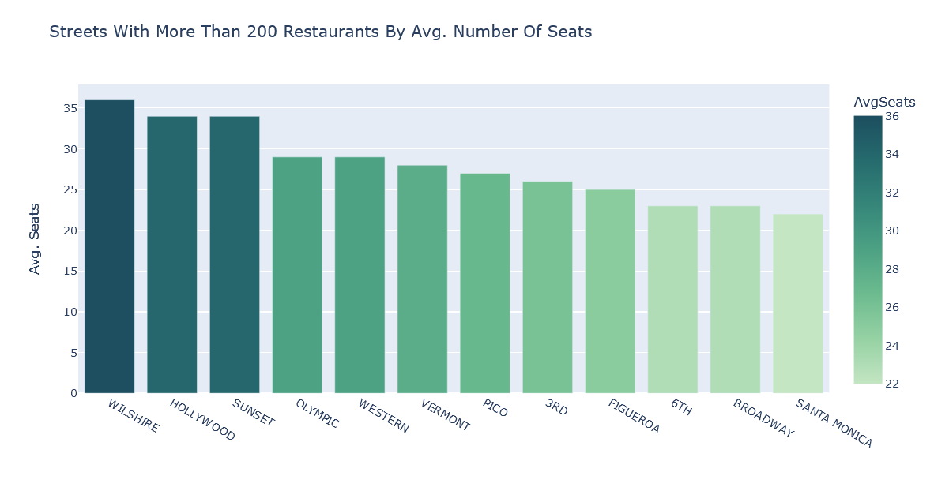
Market Research: Location by seats

Slide 16
Market Research: Location by seats
Santa-Monica and Figueroa streets are the best fit for robot-run Café
These streets have on average have between 22-25 seats and they are in the top 10 busiest streets in terms of restaurants.

Slide 17
Overall Conclusions
In restaurant market conditions in L.A, among the top 10 busiest streets in terms of restaurant types, Santa-Monica and Figueroa streets are the most suitable to open a small robot-run Cafe.
On these streets restaurant types have on average between 22-25 seats, while the overall average size of Cafés in terms of seats in L.A is 21.
Cafés consist 4.5% market share of all dining places in L.A and 61% of the Café restaurant types belong to chains.
In L.A chains characterized by higher number of establishments and smaller number of seats in each one of them. Also the Cafe chains has on average 3 seats more than non-chains.
Those conditions points to a possibility of considering to develop a robot-run Café chain as a business step.
Those conditions points to a possibility of considering to develop a robot-run Cafe chain as a business step. The cons are that chains has their reputation so it can be harder to enter the market and the prices can be much lower. On the other hand, unique Cafes in terms of robot-run services don't take a lot of space, the maintenance cost is low, and the turnover can be high.

